Slide 1
My path to the freelance
CocoaHeadsNL Oct-22
bijdorpstudio.nl

Slide 2

Photo by Ehimetalor Akhere Unuabona on Unsplash

Slide 3
Hands up game
Notes:
Please raise the hand if you heard something about freelance/contract working
Please keep your hand if you ever thought about working as a freelancer. You’re maid auditory for this talk.
Please keep your hand if you’re working as a freelancer/contractor. Hello brother contractors! :)

Slide 4
Agenda
My motivation to start a freelance
Notices, frustration and watch outs
Is it the dead end?
Notes:
I’m the owner of a freelance entity in the Netherlands. I’m doing freelance for 1.5 years now and had two gigs already. I have a number of years of working in software development and in my last 7 years as an internal employee I had working on different bases with freelancers.
There will be some things that relate to the Netherlands. However, I expect a lot of similarities in other European countries. Including the UK.

Slide 5
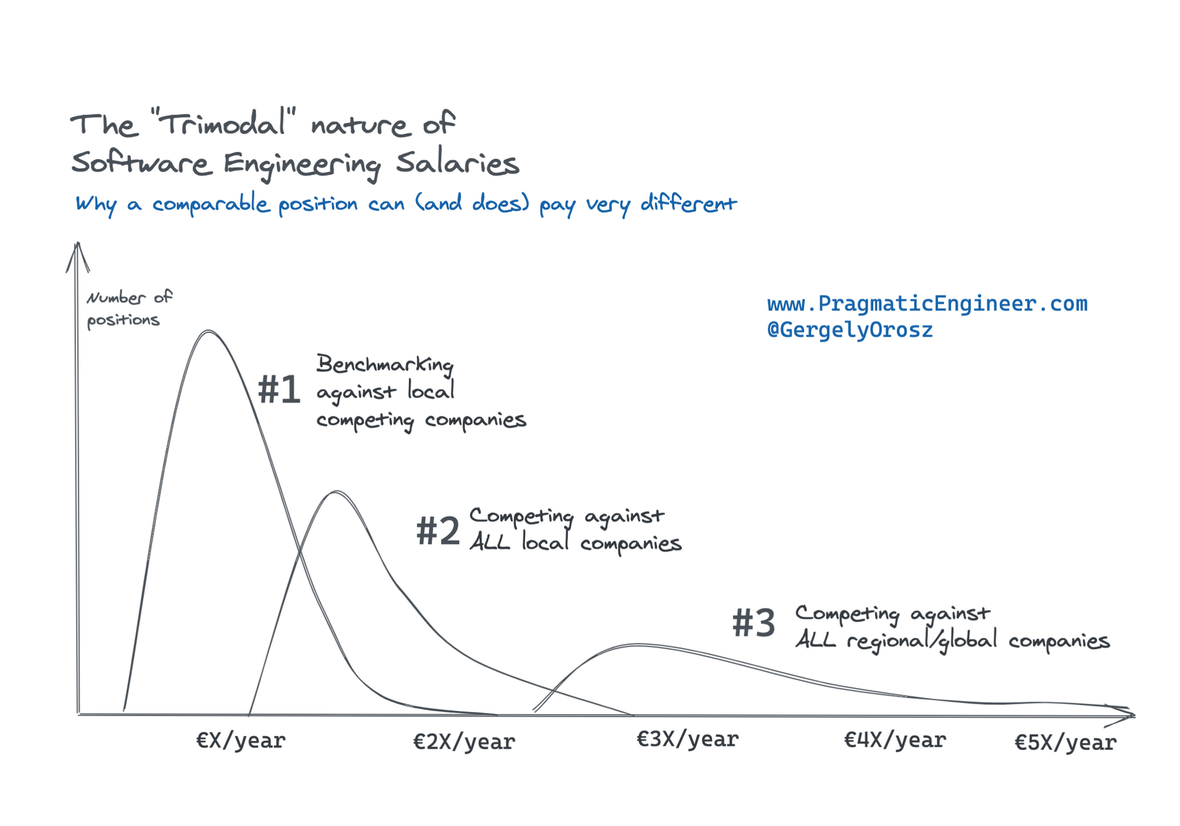
Salaries distribution
“The Trimodal Nature of Software Engineering Salaries in the Netherlands and Europe“ by Gergley Orosz
Working remote
IND - Cross border worker
Notes:
I believe this motivation is valid for the majority of new starters.
The next quality raise of the compensation.
The year I switched I was losing tax benefits from the government and my netto would noticeably drop.
There was no support action from my current employer and there was no definite option that I would pass bucket #3 hiring process.

Slide 6
Things are different when you are started

Slide 7
Things that differ
Must
Pay for your vacation and sick days
Pay BTW to the tax office every quarter
Legal liability insurance
Report company purchases, expenses and assets
Notes:
I knew the cases where a company would pay for vacations - 10 days or two weeks. This is yet an exception. The rule is you’re not paid if you’re not working.
If your client is in the Netherlands you’re billing them including BTW. That BTW you have to transfer to the tax office quarterly. Just remember it is not your money.
If you work for medicine, banking, or user-sensitive data you will be asked to have liability insurance for possible damages.
Remember that as much you report as expenses as less you will be taxed by the garment on the income. So think carefully about your purchases that might be treated as company ones. You also will receive quarterly BTW return from the tax office on these purchases.

Slide 8
Things that differ
Nice to have
Separate bank account
Have insurance in case of disability
Save yourself for the pension
Outsource accounting - help with submission of income tax at the end of the year
Pay income tax upfront
Notes:
Company contracts usually have a statement about the disability case, not sure if it is legally required. However, when you’re a freelancer you don’t have such and whenever you’re disabled you’re living on your own savings.
The additional pension schema is a nice bonus in the Netherlands that is often in the contract for internal employees. When you’re working as a freelancer you have to save your money.
Outsource (at least first years) accounting part gives you the confidence you’re not violating laws, you might get nice pieces of advice (like I was suggested to report part of my energy bills since I work from home, or put past two years purchases as the preparation to start freelance).
You can pay the income tax upfront and not worry about stored money in your accounts. The accountant asked the approximate sum I would earn this year and submitted it to the tax office. So I was provided with a special IBAN where I can send monthly, quarterly income tax payments upfront.

Slide 9
Things that differ
Possible frustration
Your contact details are public
Coming late bills for the work done
Shorter contract periods
Dealing with requiters
Notes:
You send the bill after a working period - a month or bi-weekly. The client is obligated to pay by the due date. However, they may delay payment without any penalty.
Sometimes requirers that approaching you to the company will take premium, not of the fact of hire but will add additional cost on top of your hourly rate.
On average freelance contracts a shorter than contracts for internal people. A usual freelance contract is 6 months.

Slide 10
Not obvious findings
Time management is important
Imposter syndrome can kick you even harder
Deal with perfectionism
Greediness - billing clients as much as possible
Networking!
Notes:
Since you’re billing hourly find a balance about how to track hours for yourself, required logging or forming the bill if required
Personally, I found imposter syndrome coming to me twice more often compared to when I was internal. Probably the weight of the own responsibility, higher pay and seniority expectations.
It is awesome to work on a product that has a massive scale, you’re doing some bleeding-edge tech. However, I have to teach myself to be happy about the fact that my client is satisfied with the functionality I delivered, users are loving the product and we can take a nice vacation in a lovely place whenever we want it.
As soon as you send your first bill you might find that your earnings are much more compared to your previous compensation. Nice to remember to keep a work/life balance, you might not need to earn all money on the planet.
Due to shorter contracts and it is harder to make a long impact on the product. You can not commit in the long run. Additionally, it is wise to write code that will be easily maintainable after you leave the company.
Networking is usually the main source of the next gig. You have to sell yourself, past co-workers might recommend you, other freelancer will share some nice tips about how you can save on taxes.

Slide 11
Is freelance a dead end?

Slide 12
The future after
“Golden cage”
Dropping freelance and joining a tech enterprise
Involving in the company or consultancy

Slide 13
Recommend it
!
Freelance or not freelance
Notes:
If my wife would wake up me and ask if I would recommend working as a freelancer. I would answer “Darling, are you sure it is a great reason to wake me up? Can we wait for the morning?”
Seriously - definitely, I would recommend trying to work as a freelancer if you’re considering such an option.

Slide 14
Thank you!
Any questions?
@jack_martynov

